Slide 1
Raspberry Pi Tutorial
Phumiphat Charoentananuwat 6372093721
Nisawan Ngambenjavichaikul 6372066821

Slide 2
Software and Hardware Requirement
Win32DiskImager
Visual Studio Code with Remote-SSH Extension (Optional)
VNC Viewer (Optional)
SD card
Keyboard
Mouse
HDMI monitor

Slide 3
Workflow
Install Raspbian OS into SD card
Setup system
Enable camera
Enable ssh (Optional)
Enable VNC (Optional)
Install OpenCV
Test camera and OpenCV
Implement laplacian and canny edge detection

Slide 4
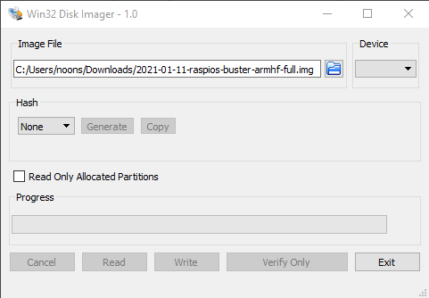
Install Raspbian OS
Download Raspbian image from https://www.raspberrypi.org/software/operating-systems/#raspberry-pi-os-32-bit
Install by Win32DiskImager

Slide 5
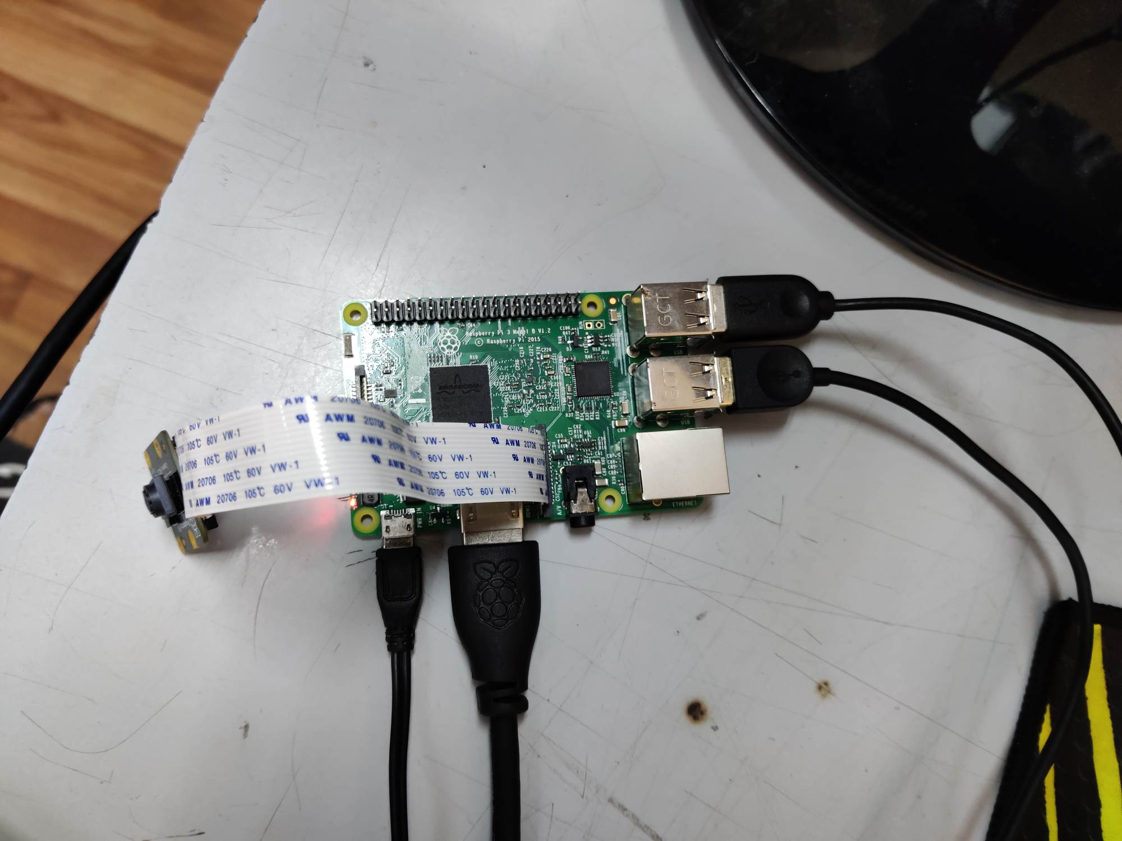

Hardware setup
usb keyboard
usb mouse
Power supply
HDMI monitor

Slide 6
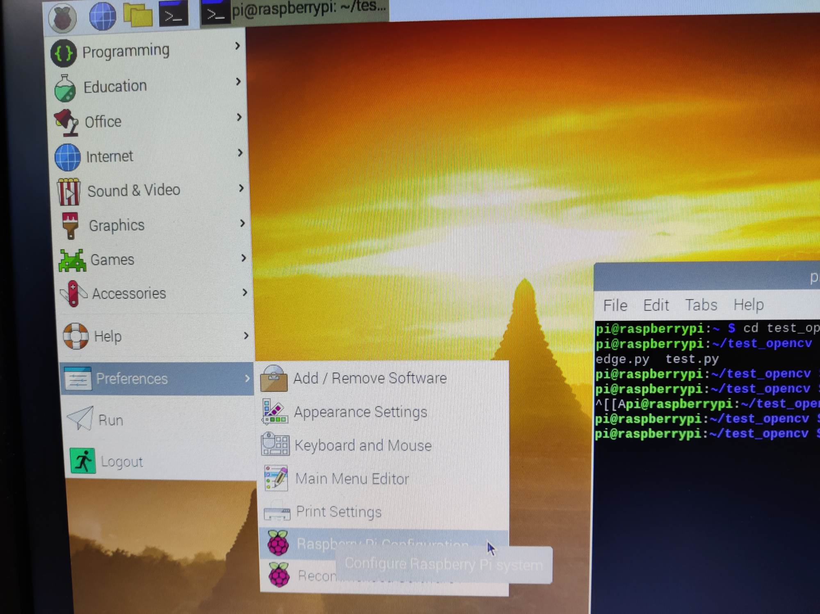
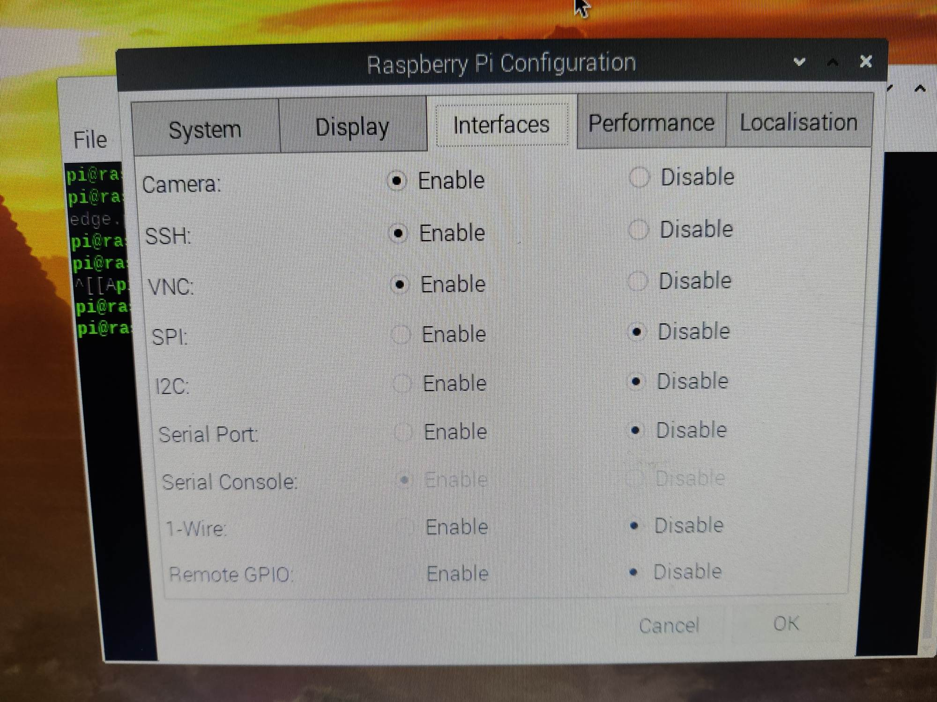

System setup

Slide 7
Install OpenCV
System update
sudo apt-get update
Sudo apt-get upgrade
Sudo rpi-update
Install dependencies image and video io
sudo apt-get install libjpeg-dev libtiff5-dev libjasper-dev libpng12-dev –y
sudo apt-get install libavcodec-dev libavformat-dev libswscale-dev libv4l-dev –y
sudo apt-get install libxvidcore-dev libx264-dev
Install HiGUI
Sudo apt-get install libgtk2.0-dev libgtk-3-dev –y
Sudo apt-get install libatlaas-base-dev gfortran –y
Install OpenCV
Sudo apt-get install python3-opencv

Slide 8
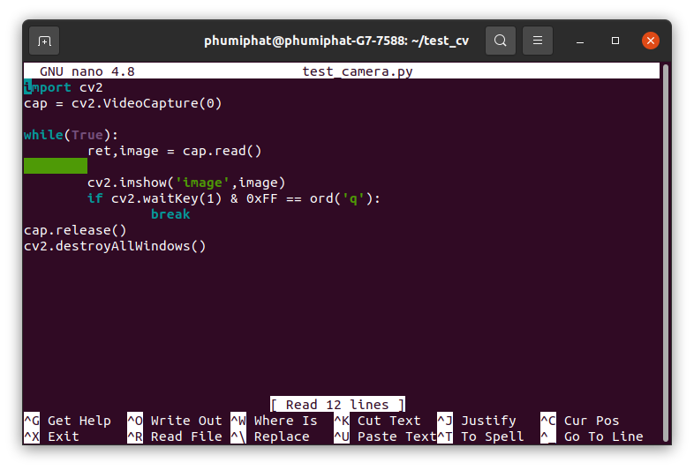
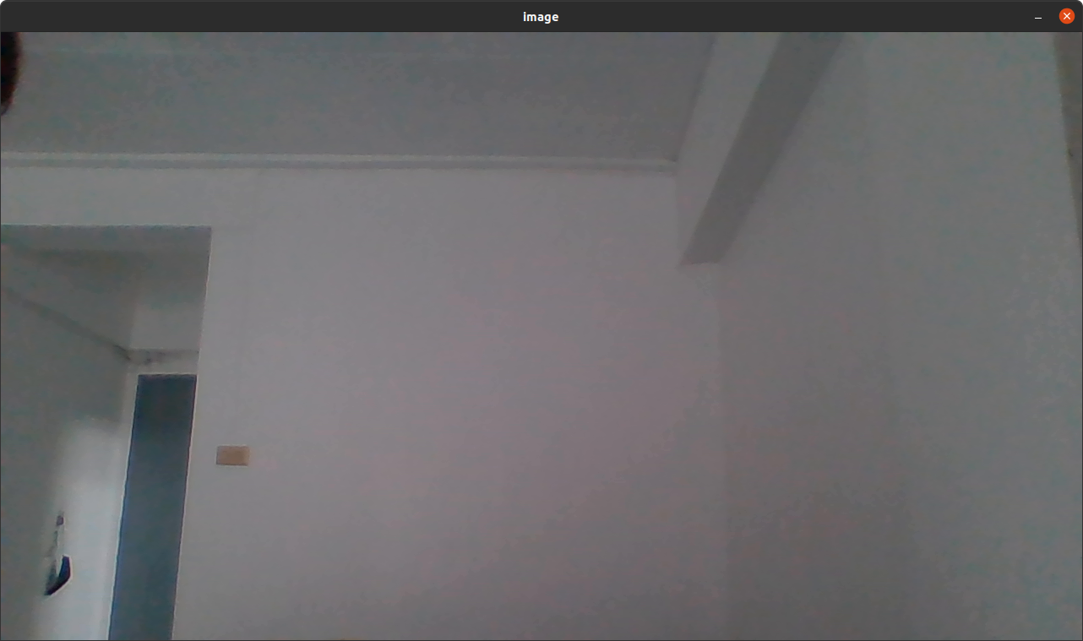
Experiment (1)
Test picamera and OpenCV

Slide 9
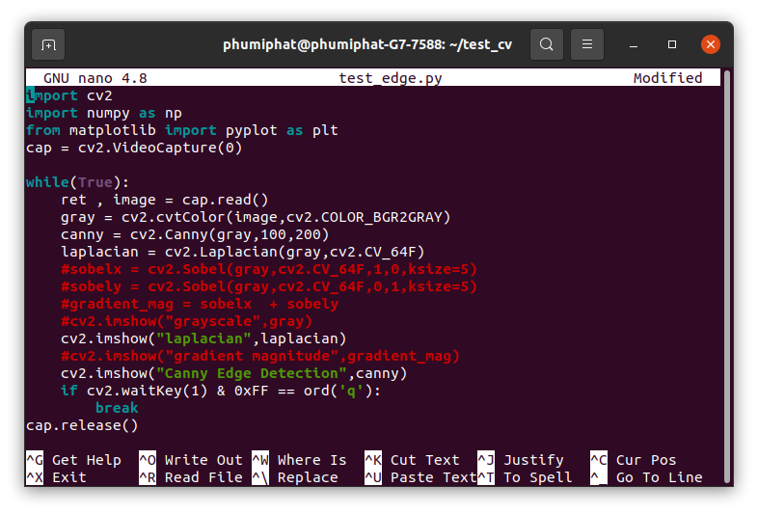
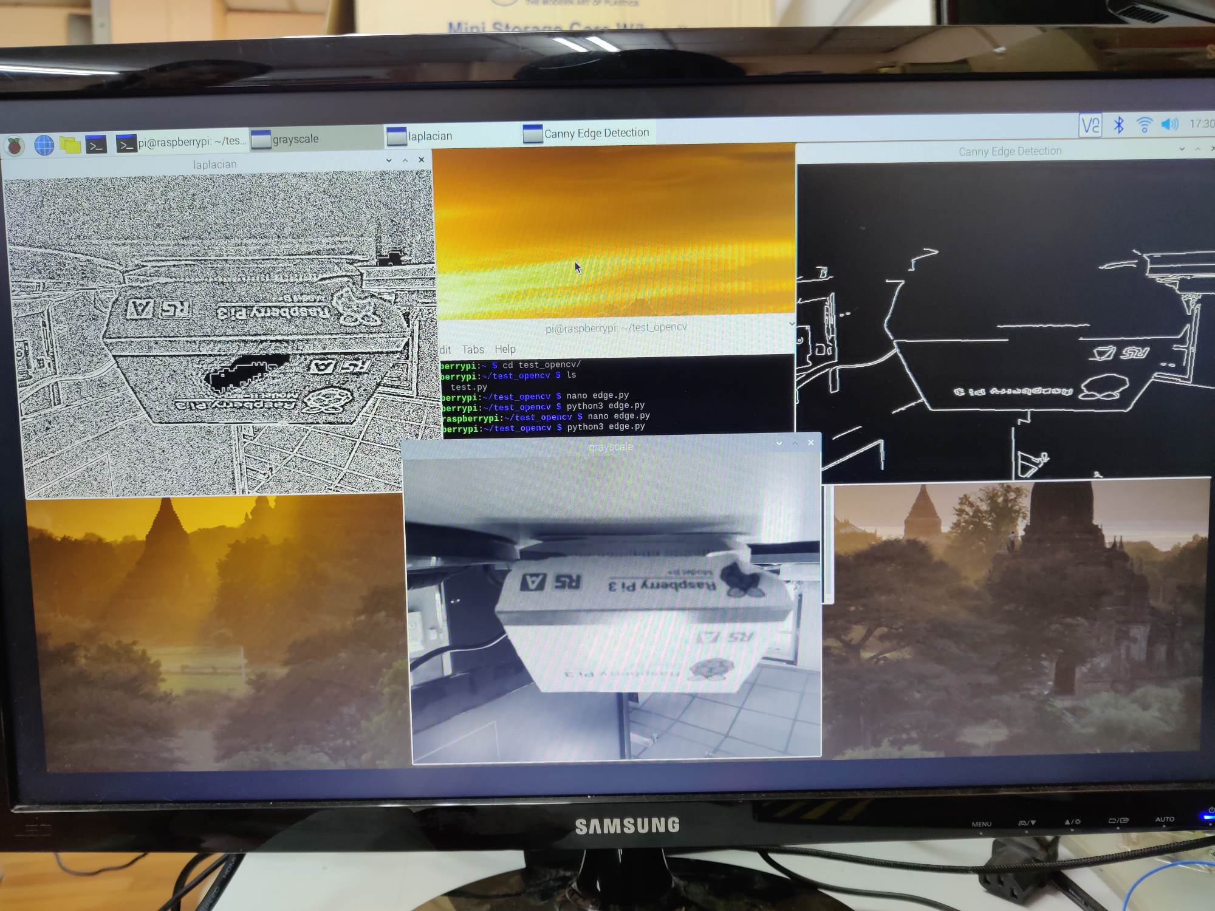
Experiment (2)
Implement laplacian and canny edge on raspberry pi
Demo video : https://www.youtube.com/watch?v=3j-d8IbfJ8I

Slide 10
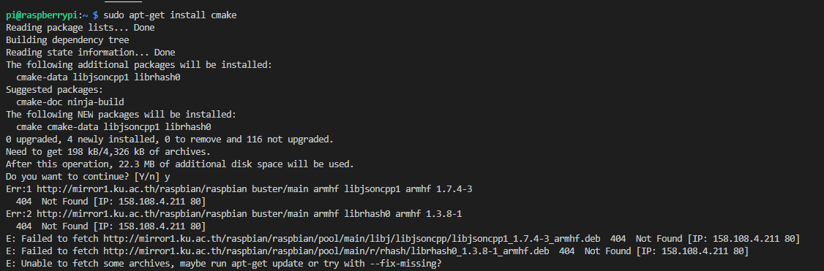
Problem : Error 404 : not found IP

Slide 11
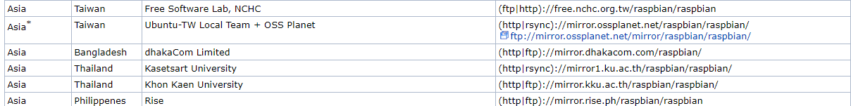
Problem : Error 404 : not found IP
Solve by :
Sudo nano /etc/apt/source.list
Go to http://www.raspbian.org/RaspbianMirrors
Select one url and replace the url above that got highlight.
Then try to do the previous command again.
deb http://raspbian.raspberrypi.org/raspbian/ stretch main contrib non-free rpi # Uncomment line below then 'apt-get update' to enable 'apt-get source' #deb-src http://raspbian.raspberrypi.org/raspbian/ stretch main contrib non-free rpi

Slide 12
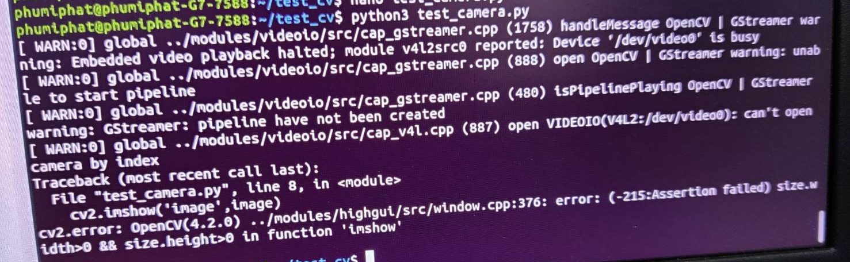
Problem : Can’t access camera
Can’t access camera because it wasn’t released.
We got this problem in ubuntu laptop. But we think it can appear in Rpi too.
At first, we tried to disable camera and kill process tree. But it didn’t work.
Finally, we used sudo reboot to reset the system.

